Slide 1
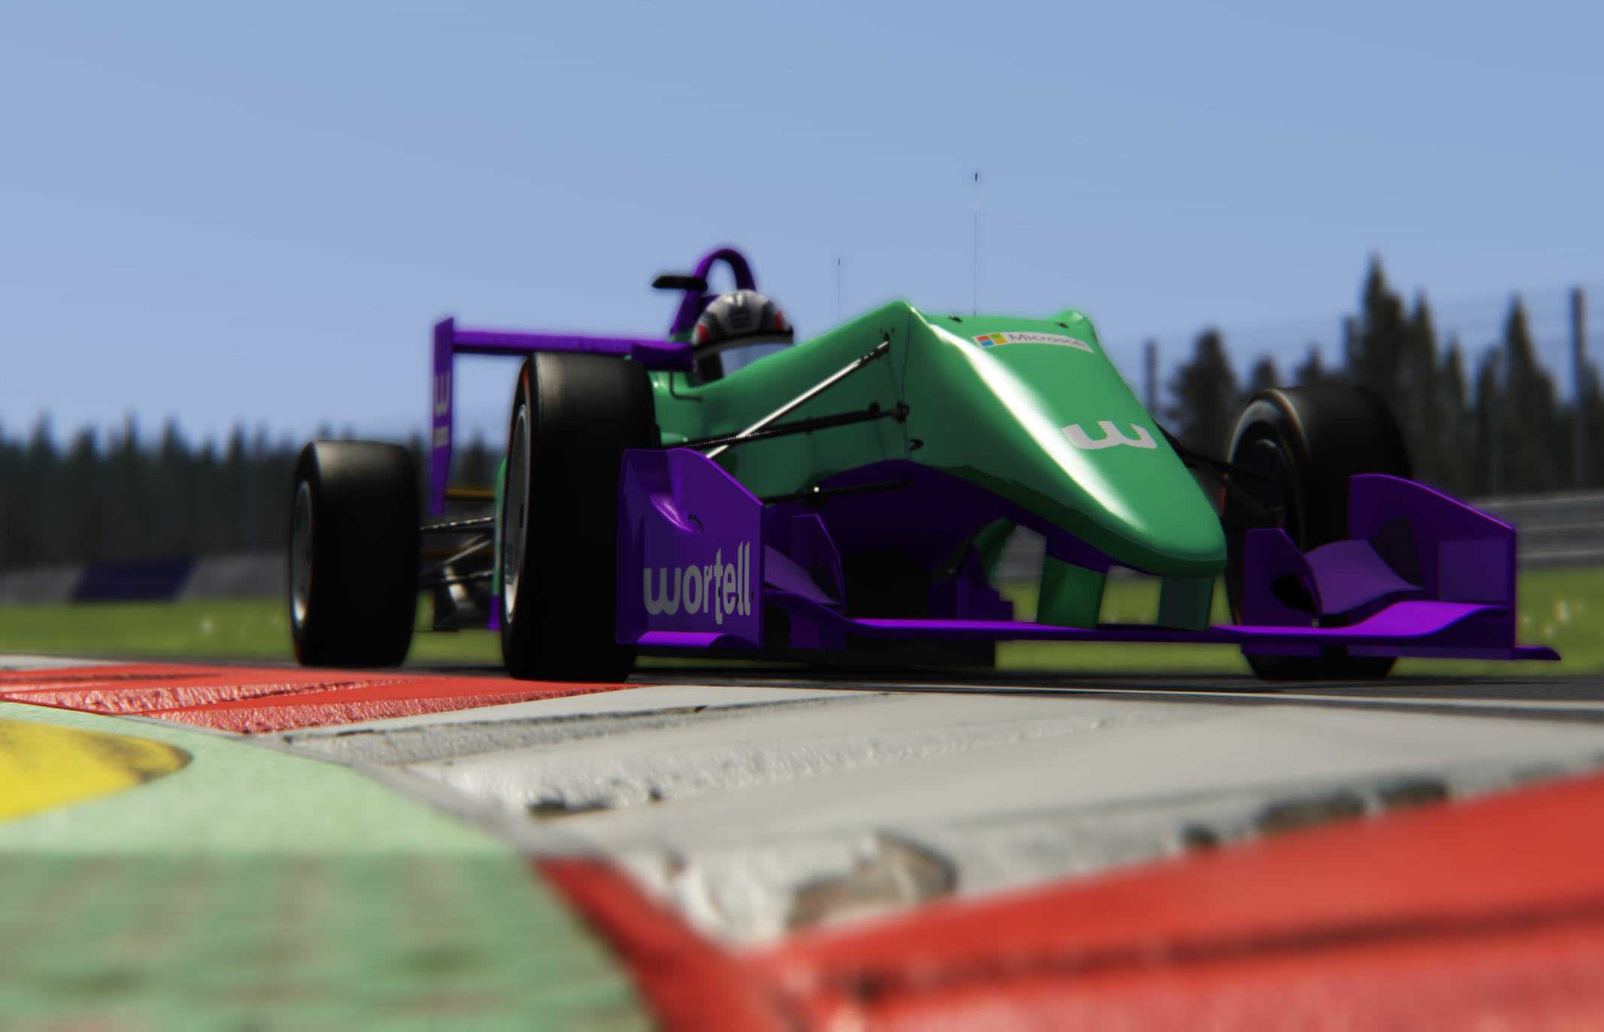

Racing with/on

Slide 2


About us: Sjoerd Leensen & Timo Ordeman

Slide 3
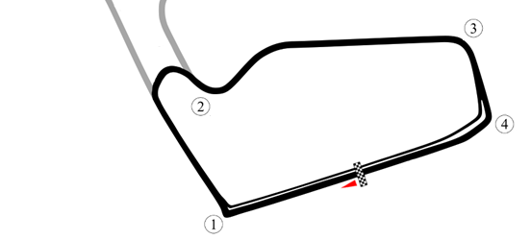



What we will discuss today:
1. we are driving at red bull ring national circuit in austria
2. In a f3 car
3. With you as driver
4. With data processed and analysed in Azure Cloud

Slide 4
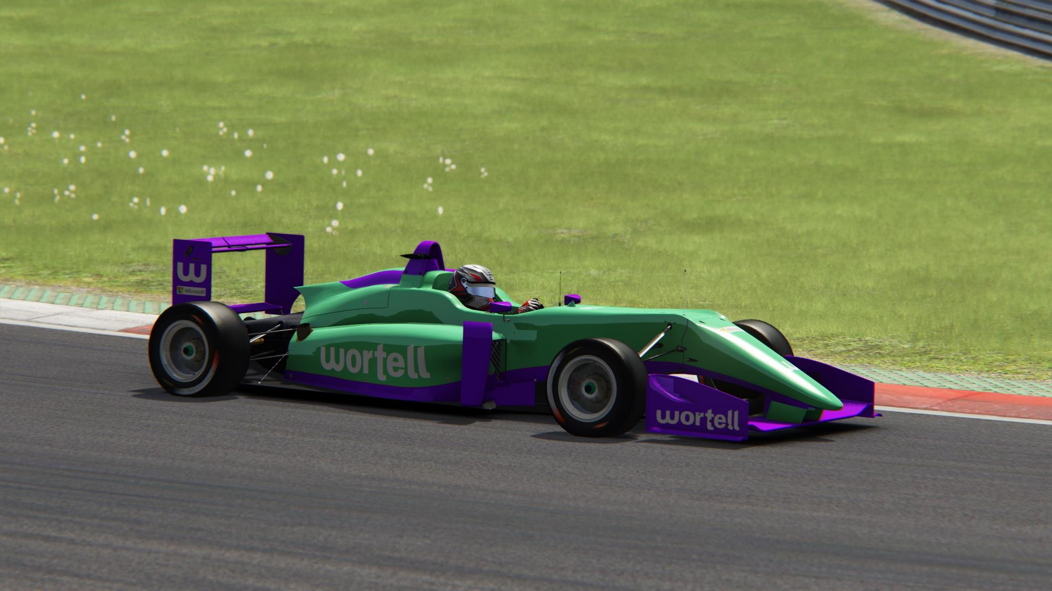
Let’s talk data

Slide 5
We all know we are sitting on a bunch of data
Data

Slide 6
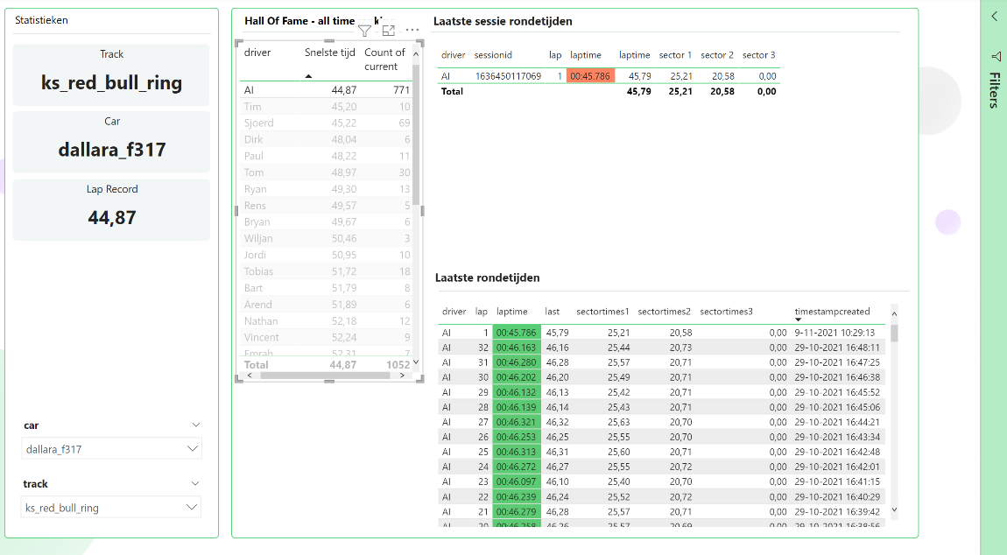
The standard insights with racing gives us our laptime information. How did we do?
BI
Data

Slide 7
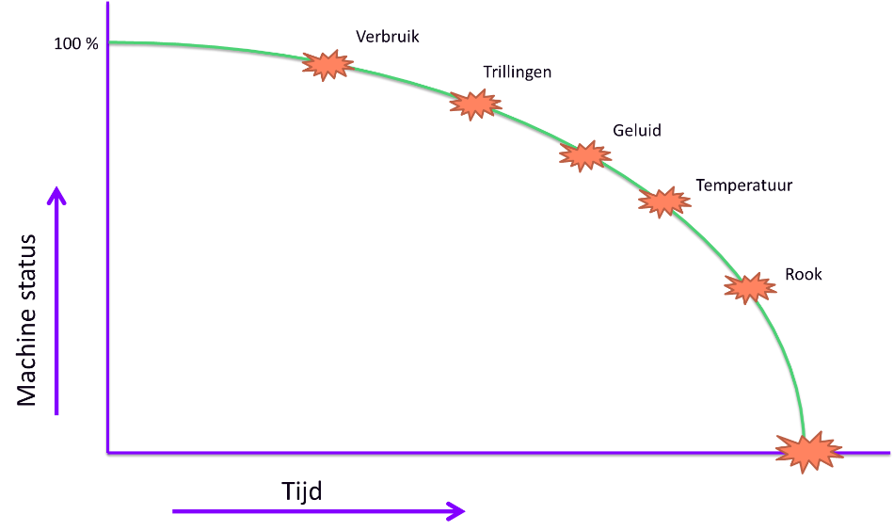


But also we need to track the health of the car
BI
Data
Fuel consumption
Vibrations
Noise
Temperature
Smoke
IOT
time
Notes:
In real life, we see a lot of cases about asset management. We can wait untill an asset (like public transport) breaks. But it is better to prevent a full break down.

Slide 8
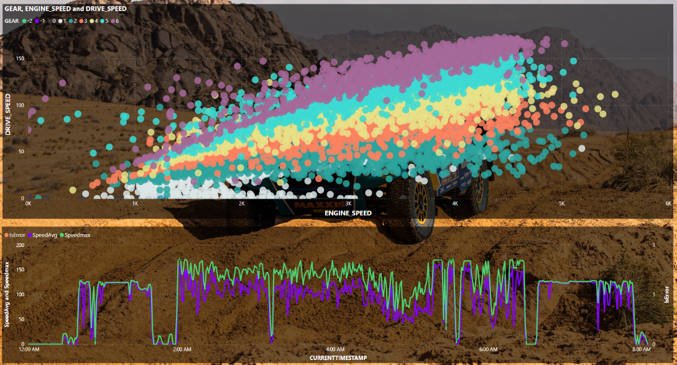
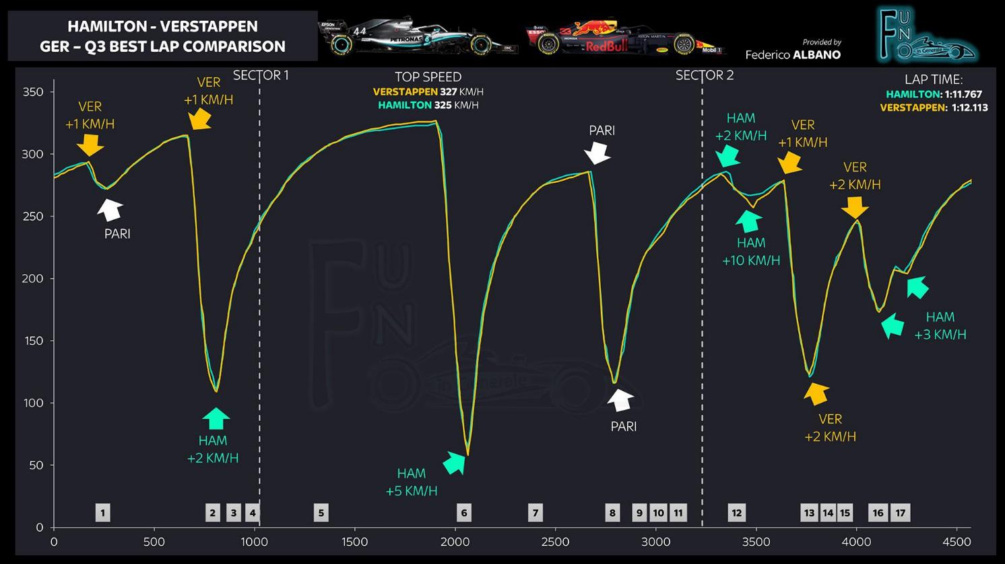
Do bigger analysis with a lot of datapoints
BI
Data
BIG(ger)
IOT
Statistics

Slide 9
And we predict
BI
Data
AI
BIGger
ml
IOT
Statistics
Predictive analytics
Notes:
We predict;
What is the change that..

Slide 10
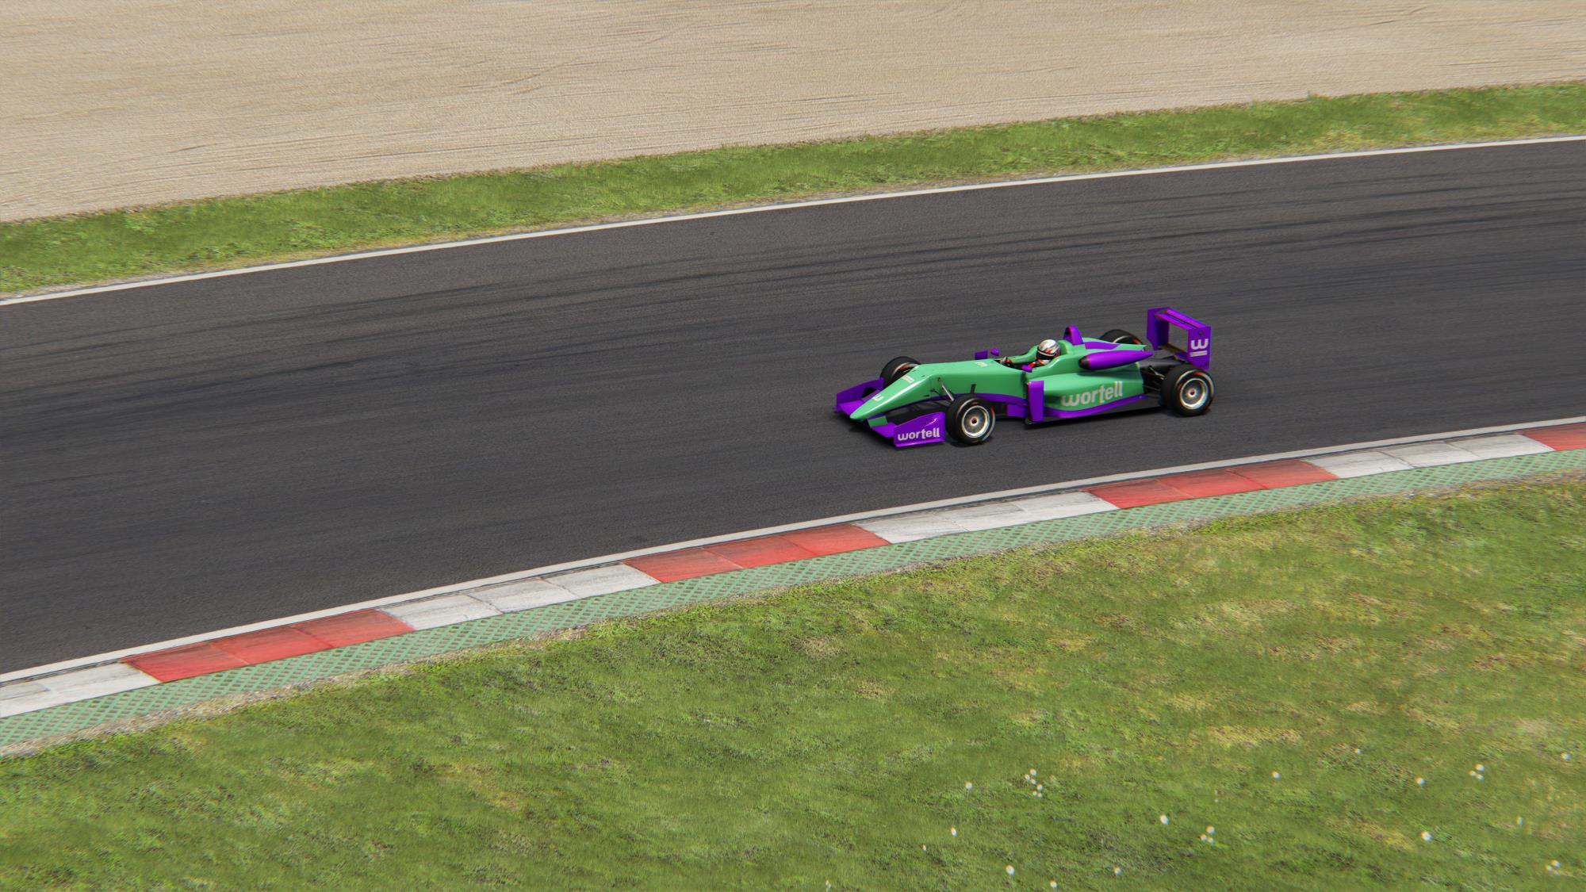
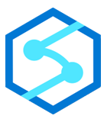







Let’s talk Azure
Notes:
Imagin delivery truck
Many applications outside of racing.

Slide 11








Source
Ingest
Store
Process
Present
Live Monitor
Local processing
20x per second
Ranking
(historical view)
1x per lap
Analysis &
Predictions
Data Analytics
1x per Session
Notes:
Process delivery truck..
Every car actually has a lot of sensor devices, they all keep track of something. Data of all these sensors are collected by a central computer in the car, and for the more modern cars, are being send to a central computer at the manufacturing company.
This situation appears in our normal life aswell. Trucks and trailers equipped with sensors and connected to fleet telematics systems provide insights into the mechanical health of fleets. Or GPS trackers which provide information about the current location of a truck.
So this is the flow of data. We gather the data from the car and process it in multiple ways.
Data is being streamed using Azure Eventhubs to our data lake and Synapse.
Besides streaming, there is a micro batch, which sends detailed log information about the current session to the blob storage, as well as the current laptime to…..
From there, we can analyse it in multiple locations, from a timescale database to synapse, to more analytical programs like dataiku.
Eventually we can present all this information in PowerBI or other tools, where we can show the analytical information.
Now lets look a bit more into detail into all of these components.

Slide 12
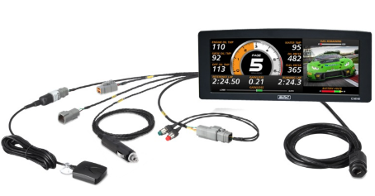
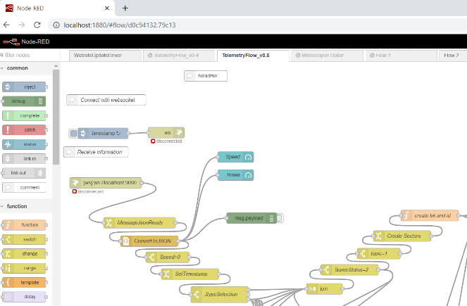

1. Local processing
Live Monitor
Ranking
(historical view)
Analysis &
Predictions
Notes:
As we just explained, a car has a variety of sensors, on our racing simulator, we create the same situation.
The game is running and we want to collect the data from these sensors. We need a bit of programming to get to the data of the game. In this case we use node-red, which acts perfectly as an event processor.
From here we can collect data, do some transformations & preprocessing, but also already visualize the data. This will provide us with a first insight in the status. But this acts as a bridge, between the game and Azure.
There are a couple of endpoints to which we send the data.
We push the data to a timescale database, which will explain a bit more in a moment.
To a datalake.
To an event hub.
Or directly to PowerBI.

Slide 13
1. Local processing
Power of API’s in Azure
Live Monitor
Ranking
(historical view)
Analysis &
Predictions
Notes:
As we just explained, a car has a variety of sensors, on our racing simulator, we create the same situation.
The game is running and we want to collect the data from these sensors. We need a bit of programming to get to the data of the game. In this case we use node-red, which acts perfectly as an event processor.
From here we can collect data, do some transformations & preprocessing, but also already visualize the data. This will provide us with a first insight in the status. But this acts as a bridge, between the game and Azure.
There are a couple of endpoints to which we send the data.
We push the data to a timescale database, which will explain a bit more in a moment.
To a datalake.
To an event hub.
Or directly to PowerBI.

Slide 14
2. Rest api’s to all azure services
SQL connection | Pull-batch
ADF connectors | Pull-batch
Eventhub | Push-Stream
REST API post / put | Push-micro batch
Notes:
Postman;
Traditionally we are used to pull data in batches, such as loading the whole ETL process overnight.
However, that's not always the case anymore. Some services are excellent to push the data.
Take our eventhub, to which we push the data from nodered.
Besides eventhub, a lot of azure resources have an API endpoint to which you can connect and push data.

Slide 15
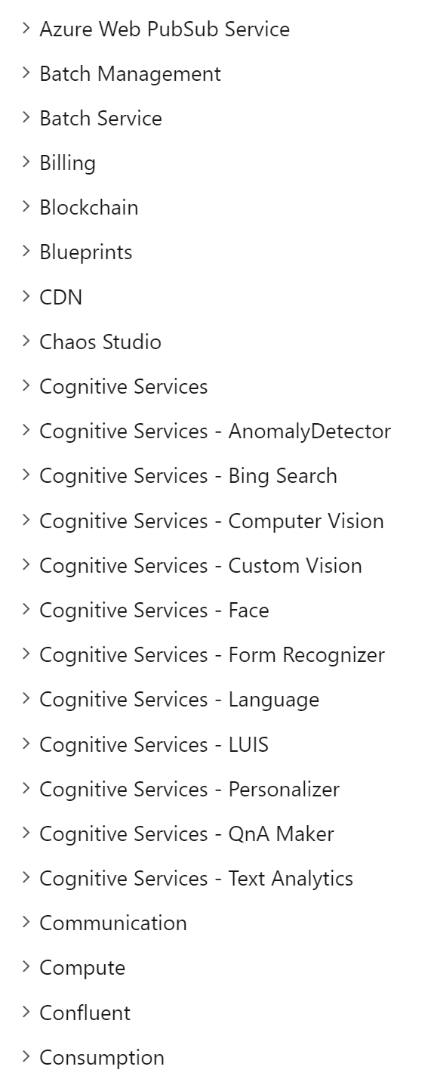
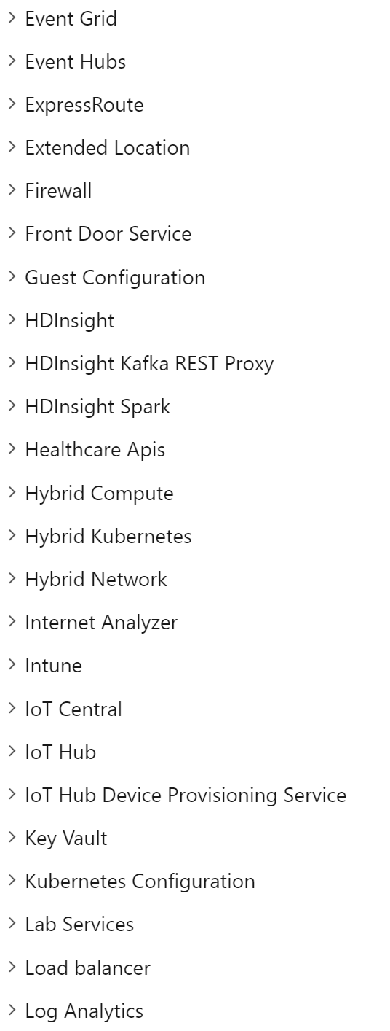
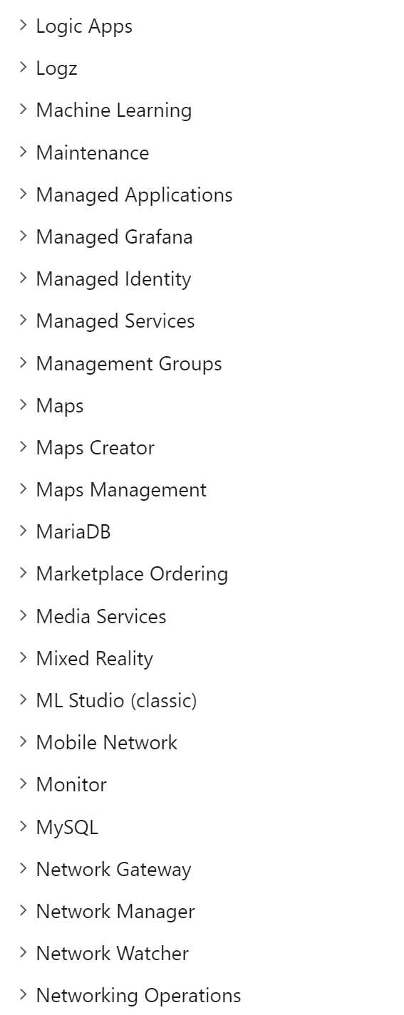
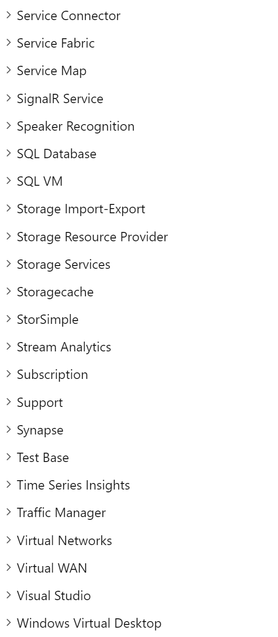
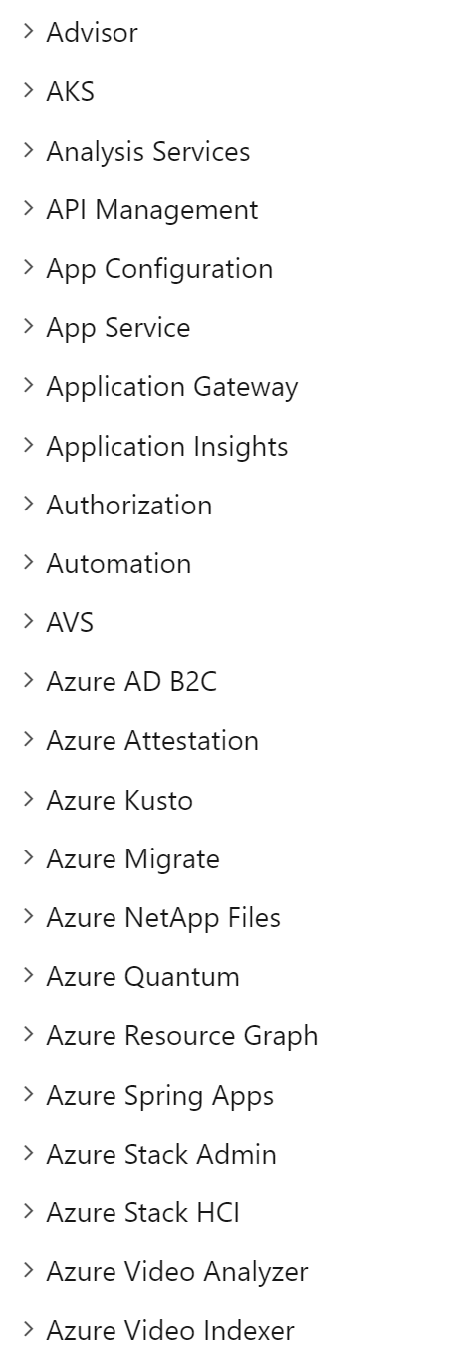
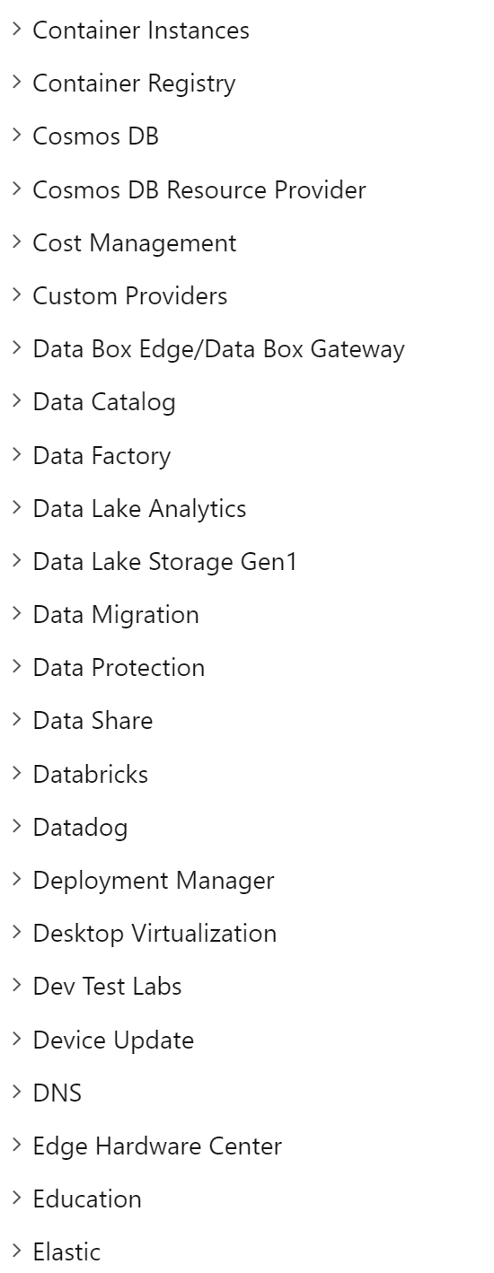
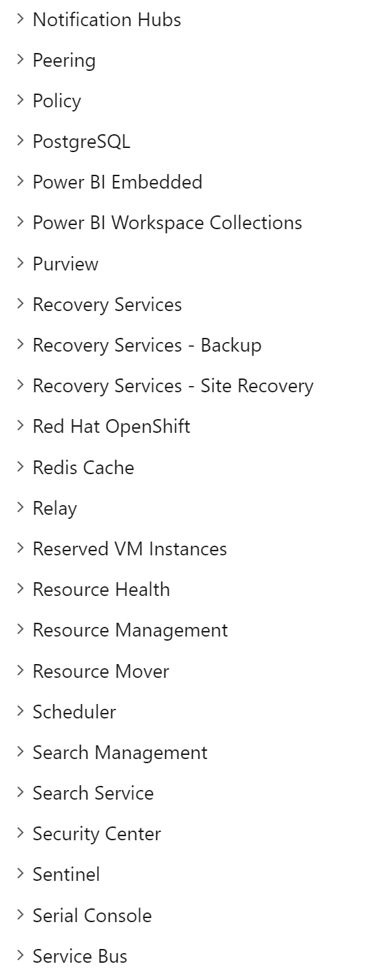
2. Azure has a lot of rest API’s
Source - Azure REST API reference - https://docs.microsoft.com/en-us/rest/api/azure/
Notes:
Link blog post…
For instance our eventhub. We can actually push the data to the eventhub, let's simulate this using postman.
Postman is an API platform for building and using API

Slide 16
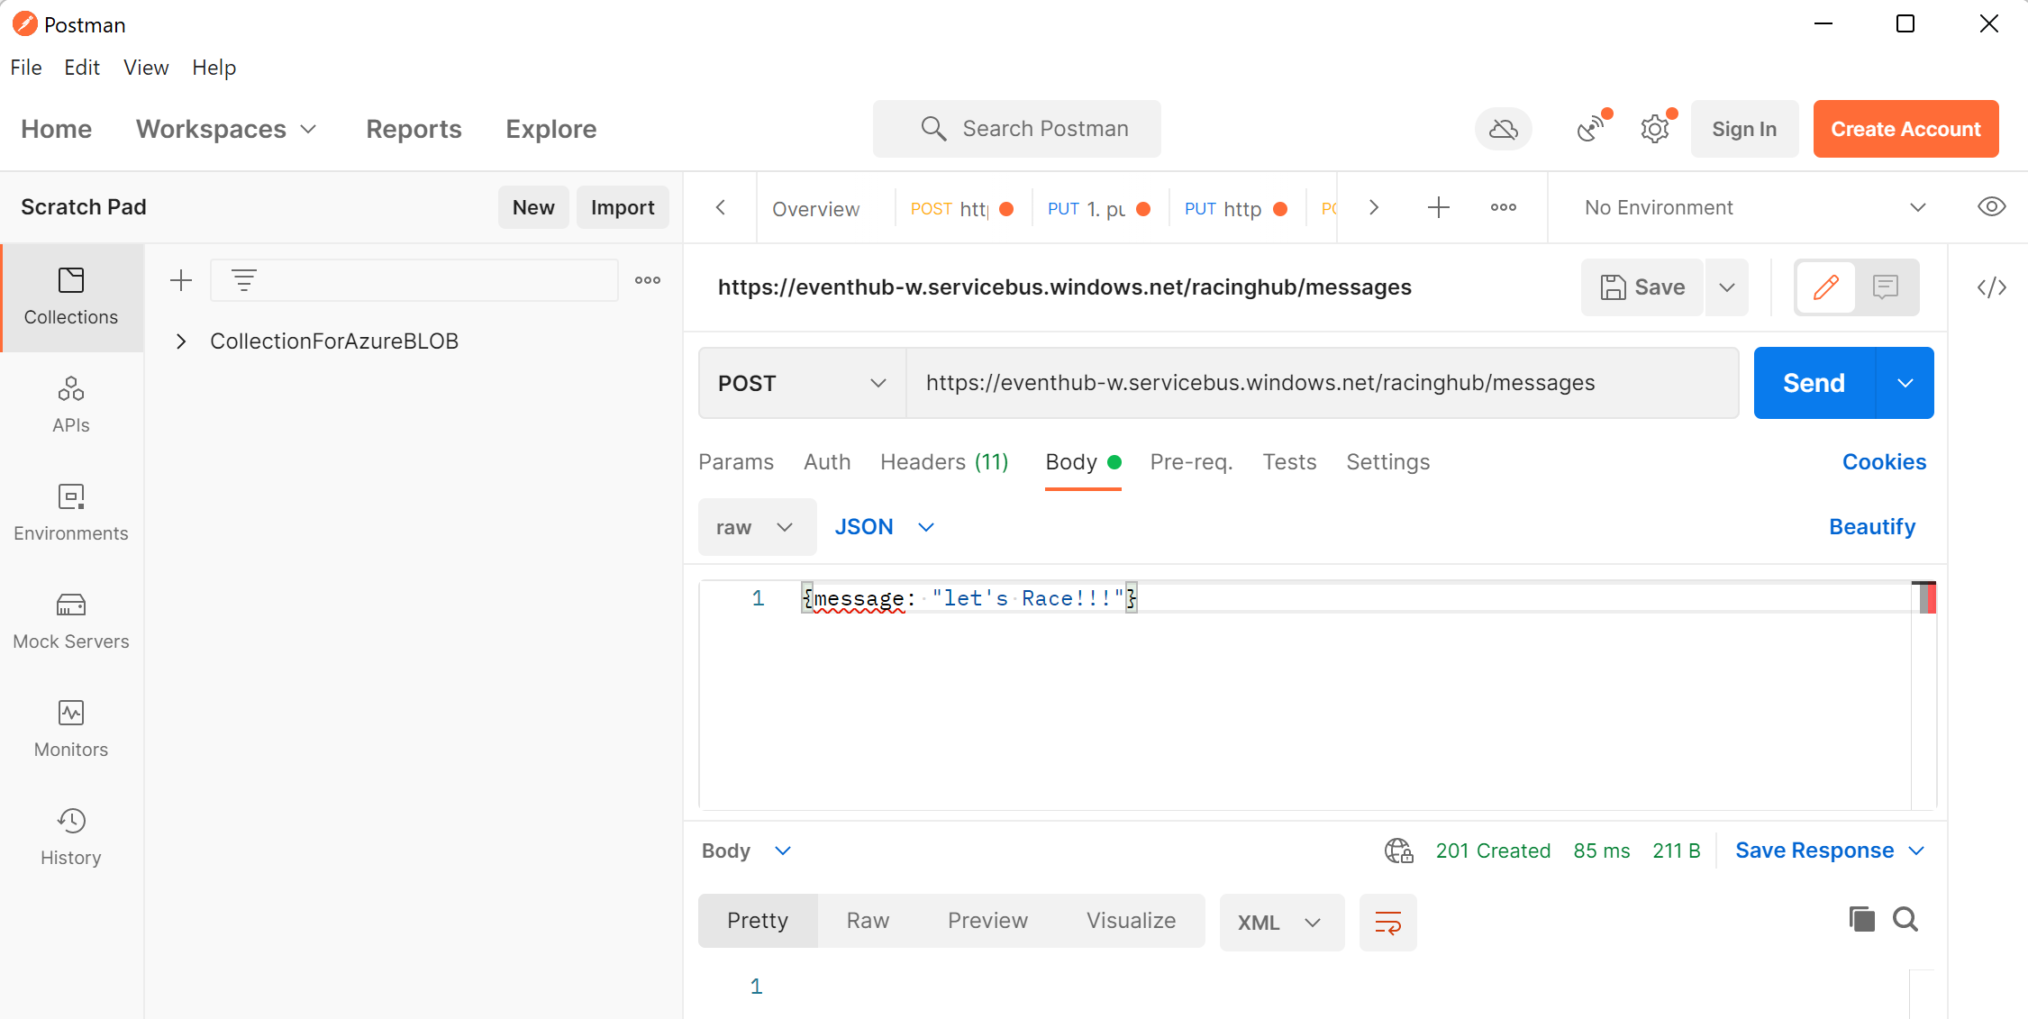
Notes:
Post Request to the API endpoint of our Eventhub.

Slide 17
3. Eventhub
Source
Ingest
Store
Process
Present
Live Monitor
Local processing
20x per second
Ranking
(historical view)
1x per lap
Analysis &
Predictions
Data Analytics
1x per Session
Notes:
Process delivery truck..
Every car actually has a lot of sensor devices, they all keep track of something. Data of all these sensors are collected by a central computer in the car, and for the more modern cars, are being send to a central computer at the manufacturing company.
This situation appears in our normal life aswell. Trucks and trailers equipped with sensors and connected to fleet telematics systems provide insights into the mechanical health of fleets. Or GPS trackers which provide information about the current location of a truck.
So this is the flow of data. We gather the data from the car and process it in multiple ways.
Data is being streamed using Azure Eventhubs to our data lake and Synapse.
Besides streaming, there is a micro batch, which sends detailed log information about the current session to the blob storage, as well as the current laptime to…..
From there, we can analyse it in multiple locations, from a timescale database to synapse, to more analytical programs like dataiku.
Eventually we can present all this information in PowerBI or other tools, where we can show the analytical information.
Now lets look a bit more into detail into all of these components.

Slide 18
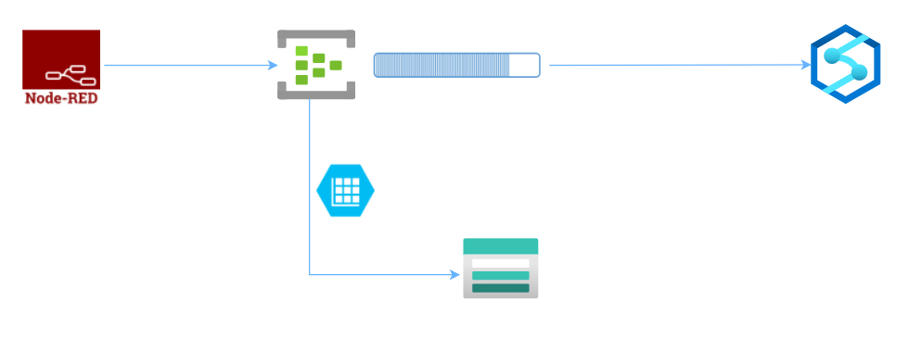
3. Eventhub
Capture
Notes:
In this case we use node-red as the event publisher.
We need something to collect the data from the publisher, namely the ingestor.
This is where the azure events hub comes into place.
Azure Event hub is a data ingestion service which can stream a huge number of messages from a variety of sources, process the messages and delivers the message to multiple endpoints.
It providies a unified streaming platform, which buffers your data with a time or size period.
An event hub must be set up in an azure event hub namespace, kind of like a management container.
Messages are stored in partitions.
The messages are load balanced over the different partitions.
Currently, we've only set up one partition, just for the ease of this demo.
The newest messages will be added to the end of the partition.
Message retention is set to 1 day.
Besides the standard event hub streaming, we use the capture feature.
This enables us to save the streaming data automatically to our data lake.
Couple of things to keep in mind when using capture.
- It must have a file name format, which some mandatory items such as namespace, partitionid.
- Capture creates a new file either within a certain time period or when a size limit is reached. It's not an and but an or.
Data is stored in Avro, a compact fast binary format with inline schema, but you need tools like apache spark to read it.
*Capture is not available in the basic tier
An event hub
We use the rest api end point of the event hub to push data to the event hub.
What is event hub
Caption

Slide 19
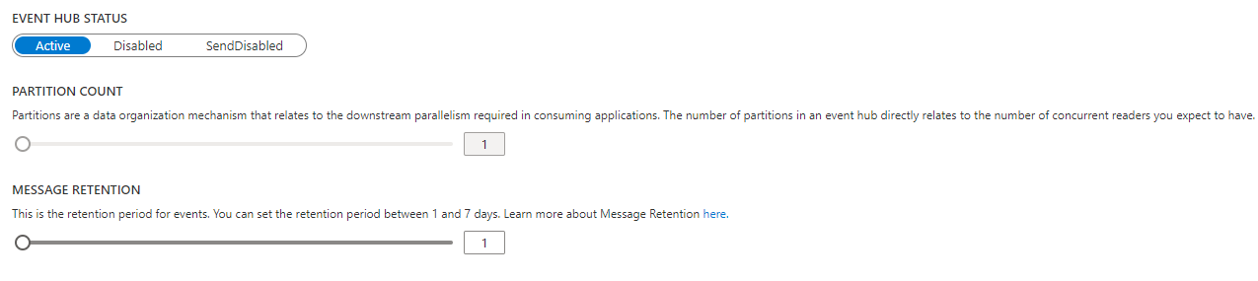
3. Eventhub
Notes:
In this case we use node-red as the event publisher.
We need something to collect the data from the publisher, namely the ingestor.
This is where the azure events hub comes into place.
Azure Event hub is a data ingestion service which can stream a huge number of messages from a variety of sources, process the messages and delivers the message to multiple endpoints.
It providies a unified streaming platform, which buffers your data with a time or size period.
An event hub must be set up in an azure event hub namespace, kind of like a management container.
Messages are stored in partitions.
The messages are load balanced over the different partitions.
Currently, we've only set up one partition, just for the ease of this demo.
The newest messages will be added to the end of the partition.
Message retention is set to 1 day.
Besides the standard event hub streaming, we use the capture feature.
This enables us to save the streaming data automatically to our data lake.
Couple of things to keep in mind when using capture.
- It must have a file name format, which some mandatory items such as namespace, partitionid.
- Capture creates a new file either within a certain time period or when a size limit is reached. It's not an and but an or.
Data is stored in Avro, a compact fast binary format with inline schema, but you need tools like apache spark to read it.
*Capture is not available in the basic tier
An event hub
We use the rest api end point of the event hub to push data to the event hub.
What is event hub
Caption

Slide 20
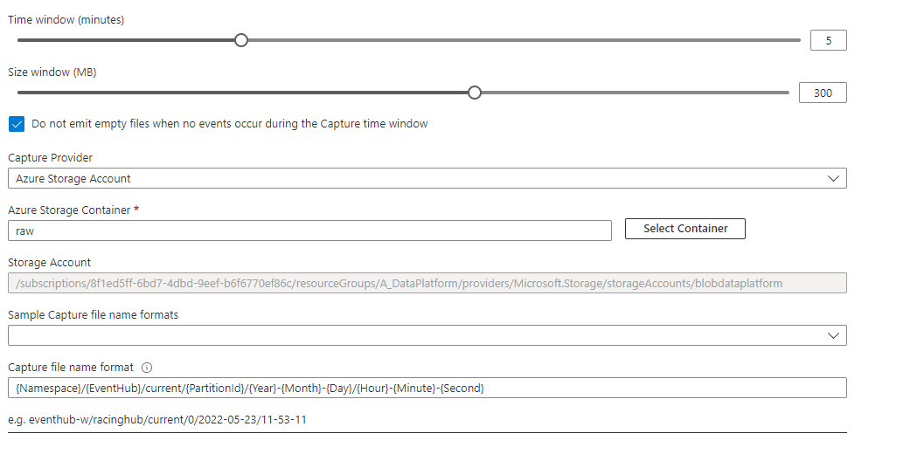
3. Eventhub
Notes:
In this case we use node-red as the event publisher.
We need something to collect the data from the publisher, namely the ingestor.
This is where the azure events hub comes into place.
Azure Event hub is a data ingestion service which can stream a huge number of messages from a variety of sources, process the messages and delivers the message to multiple endpoints.
It providies a unified streaming platform, which buffers your data with a time or size period.
An event hub must be set up in an azure event hub namespace, kind of like a management container.
Messages are stored in partitions.
The messages are load balanced over the different partitions.
Currently, we've only set up one partition, just for the ease of this demo.
The newest messages will be added to the end of the partition.
Message retention is set to 1 day.
Besides the standard event hub streaming, we use the capture feature.
This enables us to save the streaming data automatically to our data lake.
Couple of things to keep in mind when using capture.
- It must have a file name format, which some mandatory items such as namespace, partitionid.
- Capture creates a new file either within a certain time period or when a size limit is reached. It's not an and but an or.
Data is stored in Avro, a compact fast binary format with inline schema, but you need tools like apache spark to read it.
*Capture is not available in the basic tier
An event hub
We use the rest api end point of the event hub to push data to the event hub.
What is event hub
Caption

Slide 21


4. Processing
Stream processing for live monitor
When driving, we want to know the actual status of all the sensors in the car.
Processing log files like a DWH
Based on detailed logging we can do even more analysis.
Present
Live Monitor
Analysis &
Predictions
Ranking
(historical view)
Notes:
Stream notebook: https://adb-6052310818121098.18.azuredatabricks.net/?o=6052310818121098#notebook/4449818373089360/command/4449818373089361
Spark multi purpose; scalable, decouples storage from processing

Slide 22

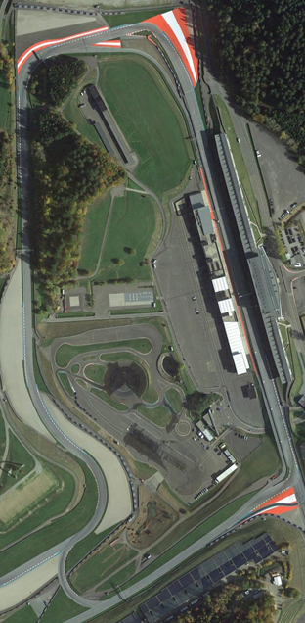
https://adb-6052310818121098.18.azuredatabricks.net/?o=6052310818121098#notebook/569974950098987/command/4412466709218248
Notes:
Process delivery truck..
Every car actually has a lot of sensor devices, they all keep track of something. Data of all these sensors are collected by a central computer in the car, and for the more modern cars, are being send to a central computer at the manufacturing company.
This situation appears in our normal life aswell. Trucks and trailers equipped with sensors and connected to fleet telematics systems provide insights into the mechanical health of fleets. Or GPS trackers which provide information about the current location of a truck.
So this is the flow of data. We gather the data from the car and process it in multiple ways.
Data is being streamed using Azure Eventhubs to our data lake and Synapse.
Besides streaming, there is a micro batch, which sends detailed log information about the current session to the blob storage, as well as the current laptime to…..
From there, we can analyse it in multiple locations, from a timescale database to synapse, to more analytical programs like dataiku.
Eventually we can present all this information in PowerBI or other tools, where we can show the analytical information.
Now lets look a bit more into detail into all of these components.

Slide 23

4a: Stream processing for live monitor
Source
Ingest
Store
Process
Present
Live Monitor
Local processing
20x per second
Ranking
(historical view)
1x per lap
Analysis &
Predictions
Data Analytics
1x per Session
Notes:
Start this notebook:
https://adb-6052310818121098.18.azuredatabricks.net/?o=6052310818121098#notebook/4449818373089360/command/3339974746839737
Azure managed grafana

Slide 24
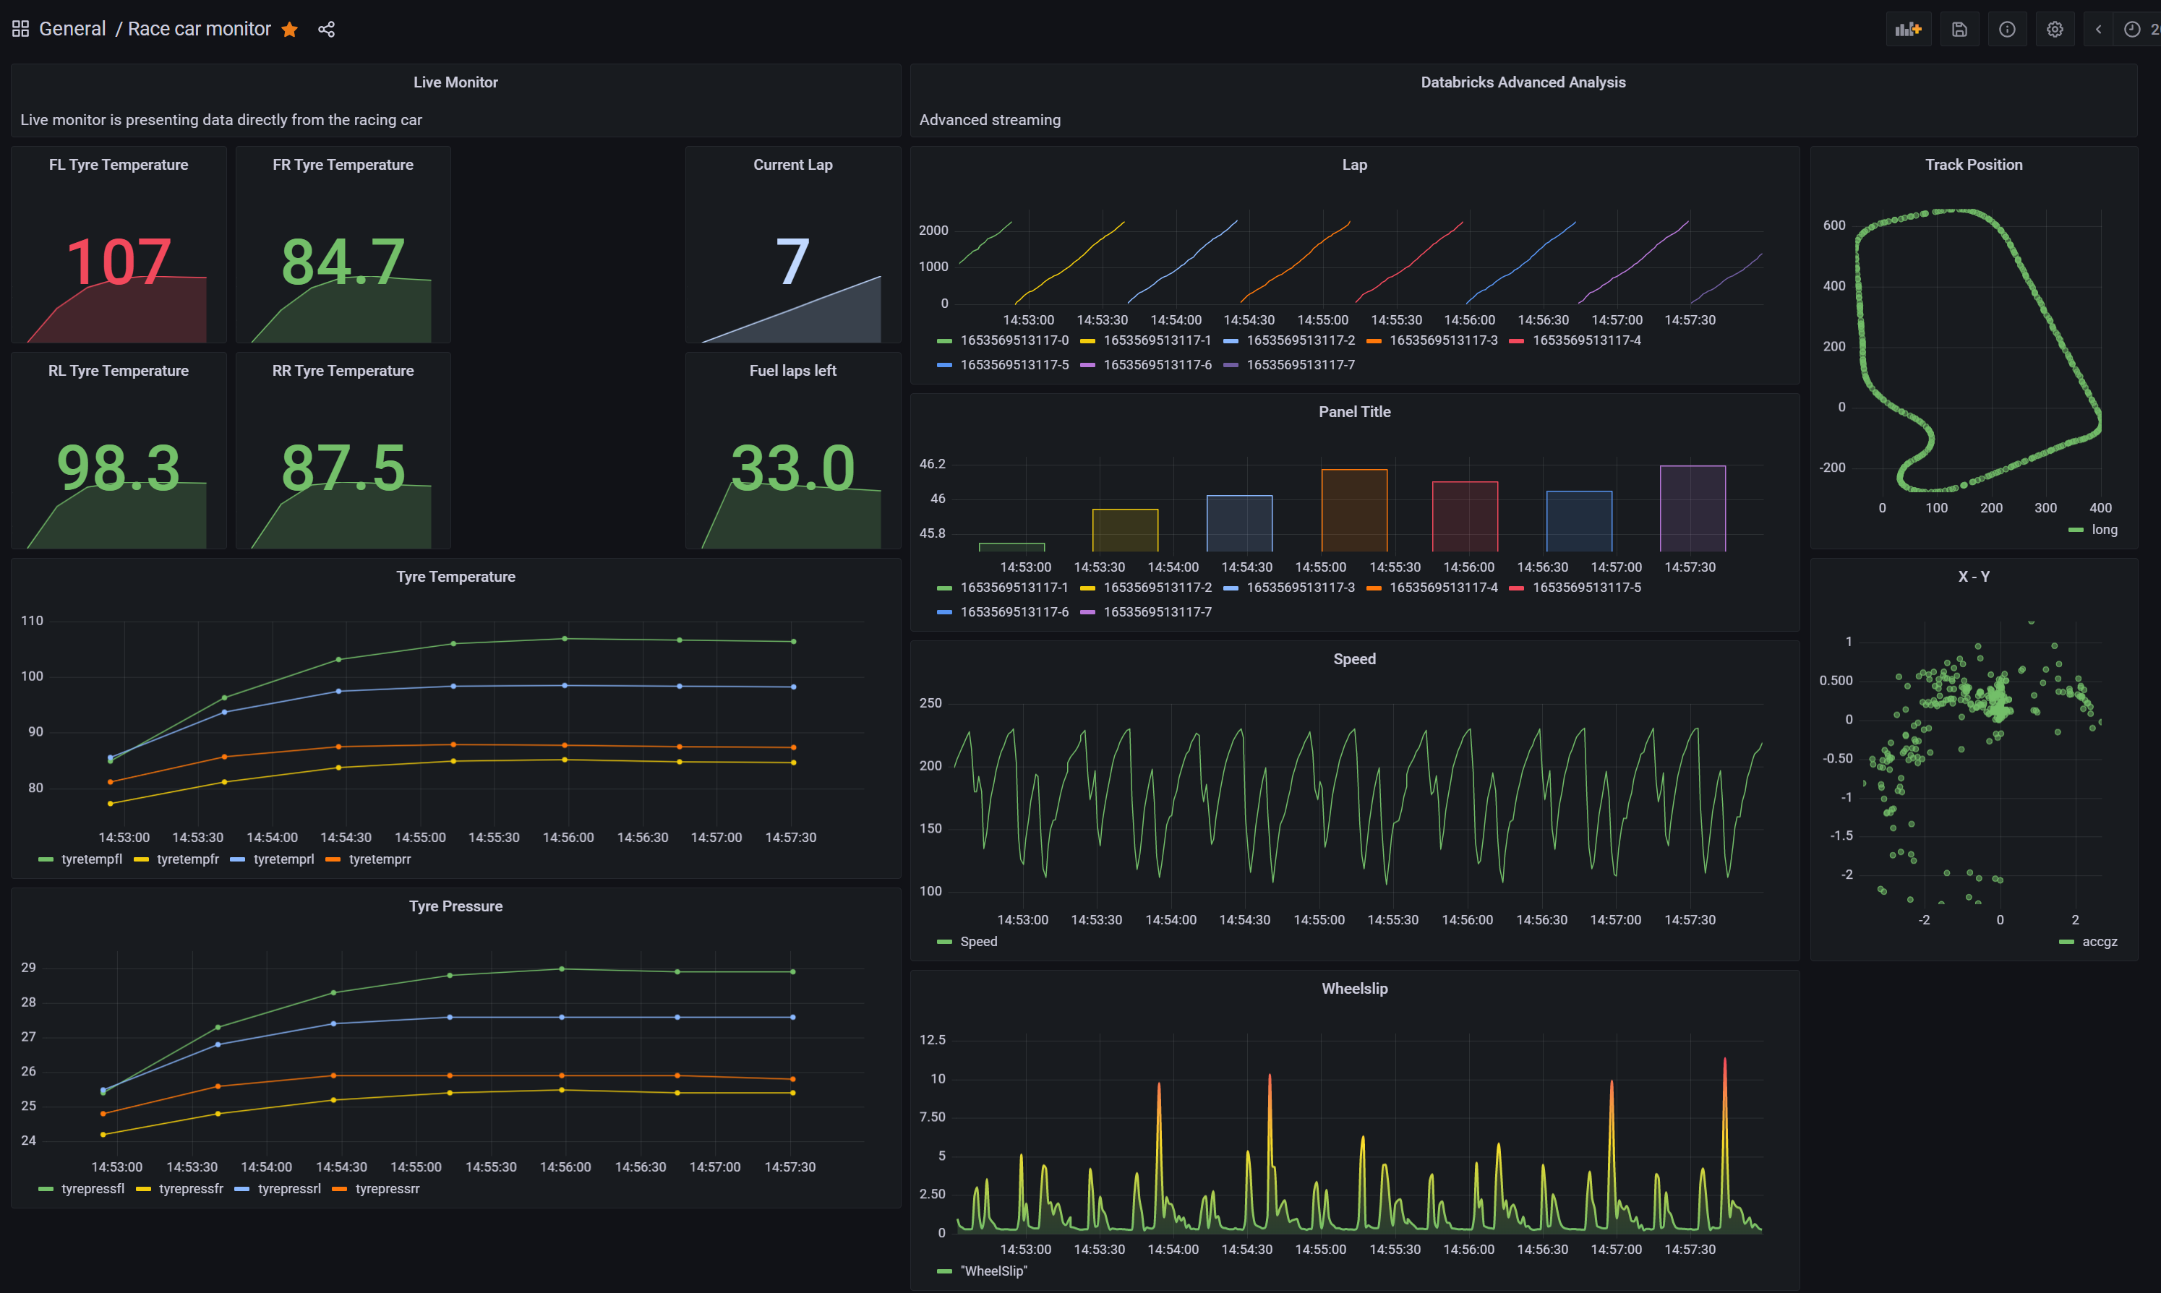
https://adataplatformgraf-d9c5cqd7hbaagvfa.weu.grafana.azure.com/d/DB1fUi9nk/race-car-monitor?orgId=1
Notes:
https://adataplatformgraf-d9c5cqd7hbaagvfa.weu.grafana.azure.com/d/DB1fUi9nk/race-car-monitor?orgId=1

Slide 25
4b: Processing log files like a DWH
Source
Ingest
Store
Process
Present
Live Monitor
Local processing
20x per second
Ranking
(historical view)
1x per lap
Analysis &
Predictions
Data Analytics
1x per Session
Notes:
1st: job: https://adb-6052310818121098.18.azuredatabricks.net/?o=6052310818121098#job/748665741262927
2nd: analysis notebook: https://adb-6052310818121098.18.azuredatabricks.net/?o=6052310818121098#notebook/569974950098987/command/4412466709218248

Slide 26

https://app.powerbi.com/view?r=eyJrIjoiZGE5ZGZjNTctZDQxZi00YmIwLWE0M2QtMGRjMmZkYTM0ZWM2IiwidCI6ImYwNDJlOWMwLTA2NjctNDRlMS1iZmUzLTNiM2Y0OTU3MTk2MSIsImMiOjl9

Slide 27
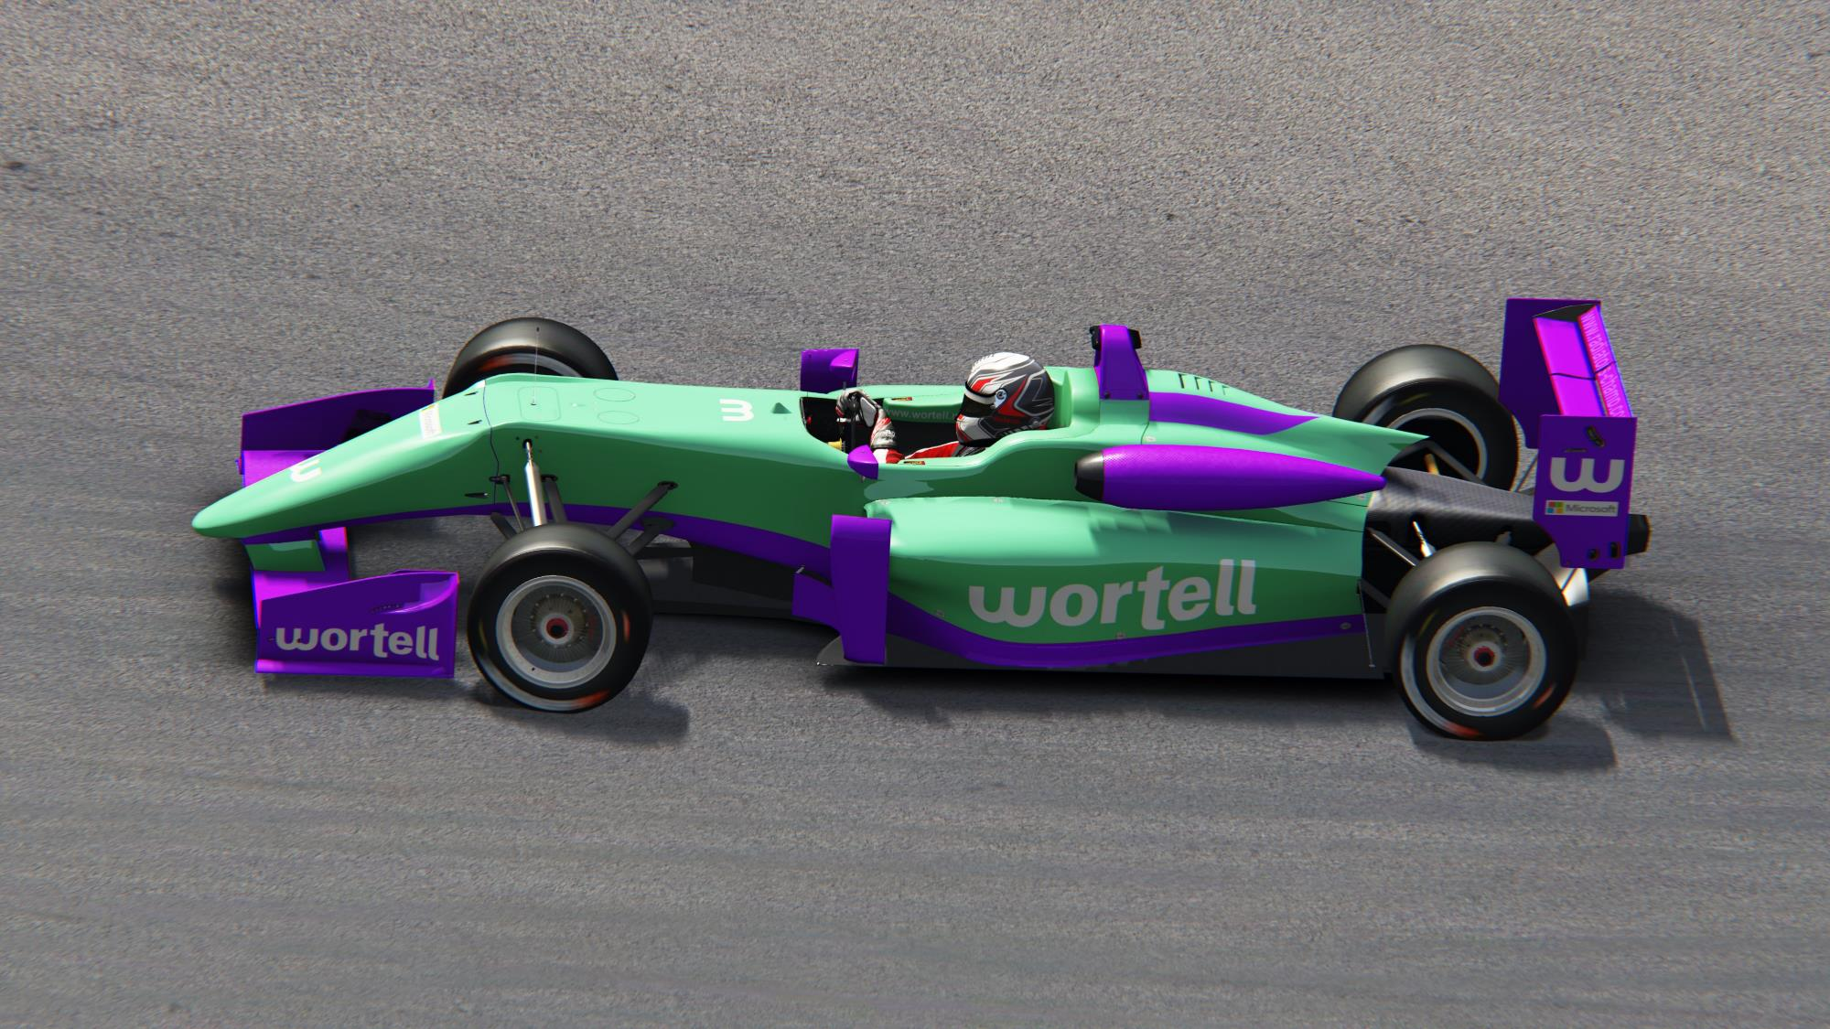
Let’s race

Slide 28
Questions?
Feedback?
https://evals.datagrillen.com/

Slide 29
Thanks you ☺

Slide 30
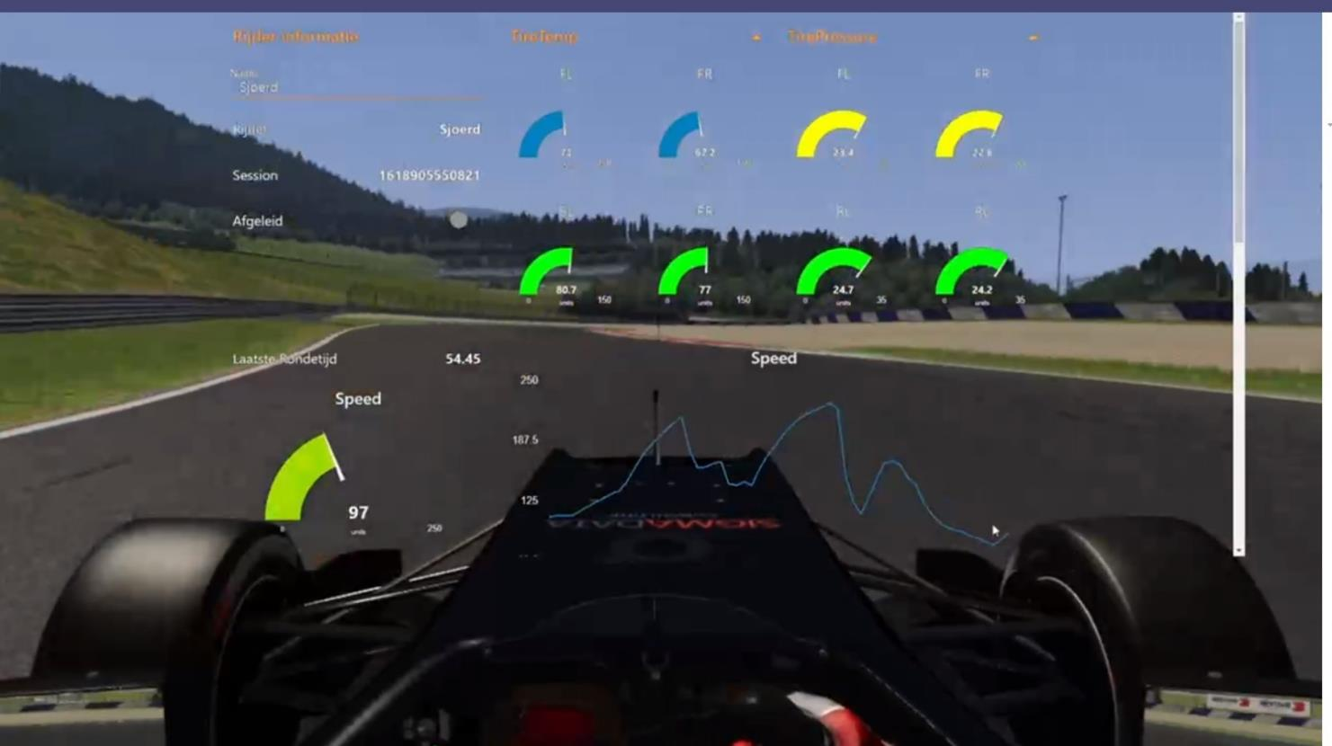
6. Bring it all together

Slide 31
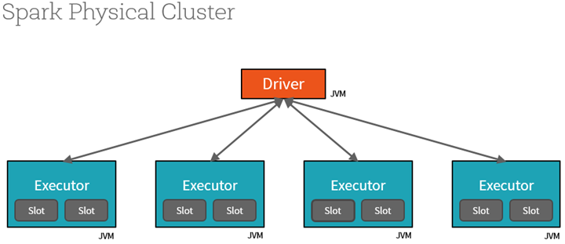
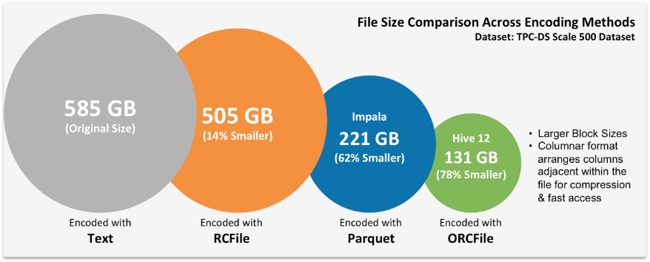
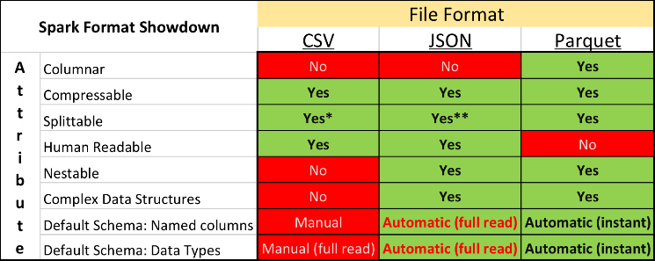
Werken in een cluster

